Slide 1
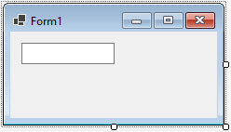
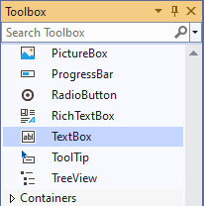
Reading Input with TextBox Control
TextBox control
a rectangular area
can accept keyboard input from the user
located in the Common Control group of the Toolbox
double click to add it to the form
default name is textBoxn
where n is 1, 2, 3, …

Slide 2
The Text Property
A TextBox control’s Text property stores the user inputs
Text property accepts only string values, e.g.
To clear the content of a TextBox control, assign an empty string("")

Slide 3
Declaring Variables Before Using Them
You can declare variables and use them later
private void showNameButton_Click(object sender, EventArgs e)
{
// Declare a string variable to hold the full name.
string fullname;
// Combine the names with a space between them. Assign the
// result to the fullname varible.
fullname = firstNameTextBox.Text + " " + lastNameTextBox.Text;
// Display the fullname variable in the fullNameLabel control.
fullNameLabel.Text = fullname;
}

Slide 4
Local Variables and Scope
A local variable belongs to the method in which it was declared
Only statements inside that method can access the variable
Scope describes the part of a program in which a variable may be accessed
Lifetime of a variable is the time period during which the variable exists in memory while the program is executing
private void firstButton_Click(object sender, EventArgs e)
{
string myName;
myName = nameTextBox.Text;
}
private void secondButton_Click(object sender, EventArgs e)
{
outputLabel.Text = myName;
}
ERROR

Slide 5
Inputting and Outputting Numeric Values
Input collected from the keyboard are considered combinations of characters (or string literals) even if they look like a number to you
A TextBox control reads keyboard input, such as 25.65. However, the TextBox treats it as a string, not a number.
In
use the following Parse methods to convert string to numeric data types:
int.Parse
double.Parse
decimal.Parse
Examples:
int hoursWorked = int.Parse(hoursWorkedTextBox.Text);
double temperature = double.Parse(temperatureTextBox.Text);

Slide 6
Displaying Numeric Values
The Text property of a control only accepts string literals
To display a number in a TextBox or Label control requires you to convert a numeric data to string type
In
all variables work with the ToString method to convert the value of the variables to strings:
decimal grossPay = 1550.0m;
grossPayLabel.Text = grossPay.ToString();
int myNumber = 123;
MessageBox.Show(myNumber.ToString());
Another option is “implicit string conversion with the + operator”:
int idNumber = 1044;
string output = "Your ID number is " + idNumber;

Slide 7
Formatting Numbers with the ToString Method
The ToString method can optionally format a number to appear in a specific way
The following table lists the Format Strings and how they work with sample outputs
Format String | Description | Number | ToString() | Result
"N" or "n" | Number format | 12.3 | ToString("n3") | 12.300
"F" or "f" | Fixed-point scientific format | 123456.0 | ToString("f2") | 123456.00
"E" or "e" | Exponential scientific format | 123456.0 | ToString("e3") | 1.235e+005
"C" or "c" | Currency format | -1234567.8 | ToString("C") | ($1,234,567.80)
"P" or "p" | Percentage format | .234 | ToString("P") | 23.40%

Slide 8
Simple Exception Handling
An exception is an unexpected error that happens while a program is running
If an exception is not handled by the program, the program will abruptly halt
This allows you to write code that responds to exceptions. Such code is known as an exception handler.

Slide 9
Handling Exceptions with try-catch
General format of the try-catch statement:
try
{
statement;
statement;
etc.
}
catch
{
statement;
statement;
etc.
}
The try block is where you place the statements that can cause an exception
The catch block is where you place statements that respond to the exception when it happens

Slide 10
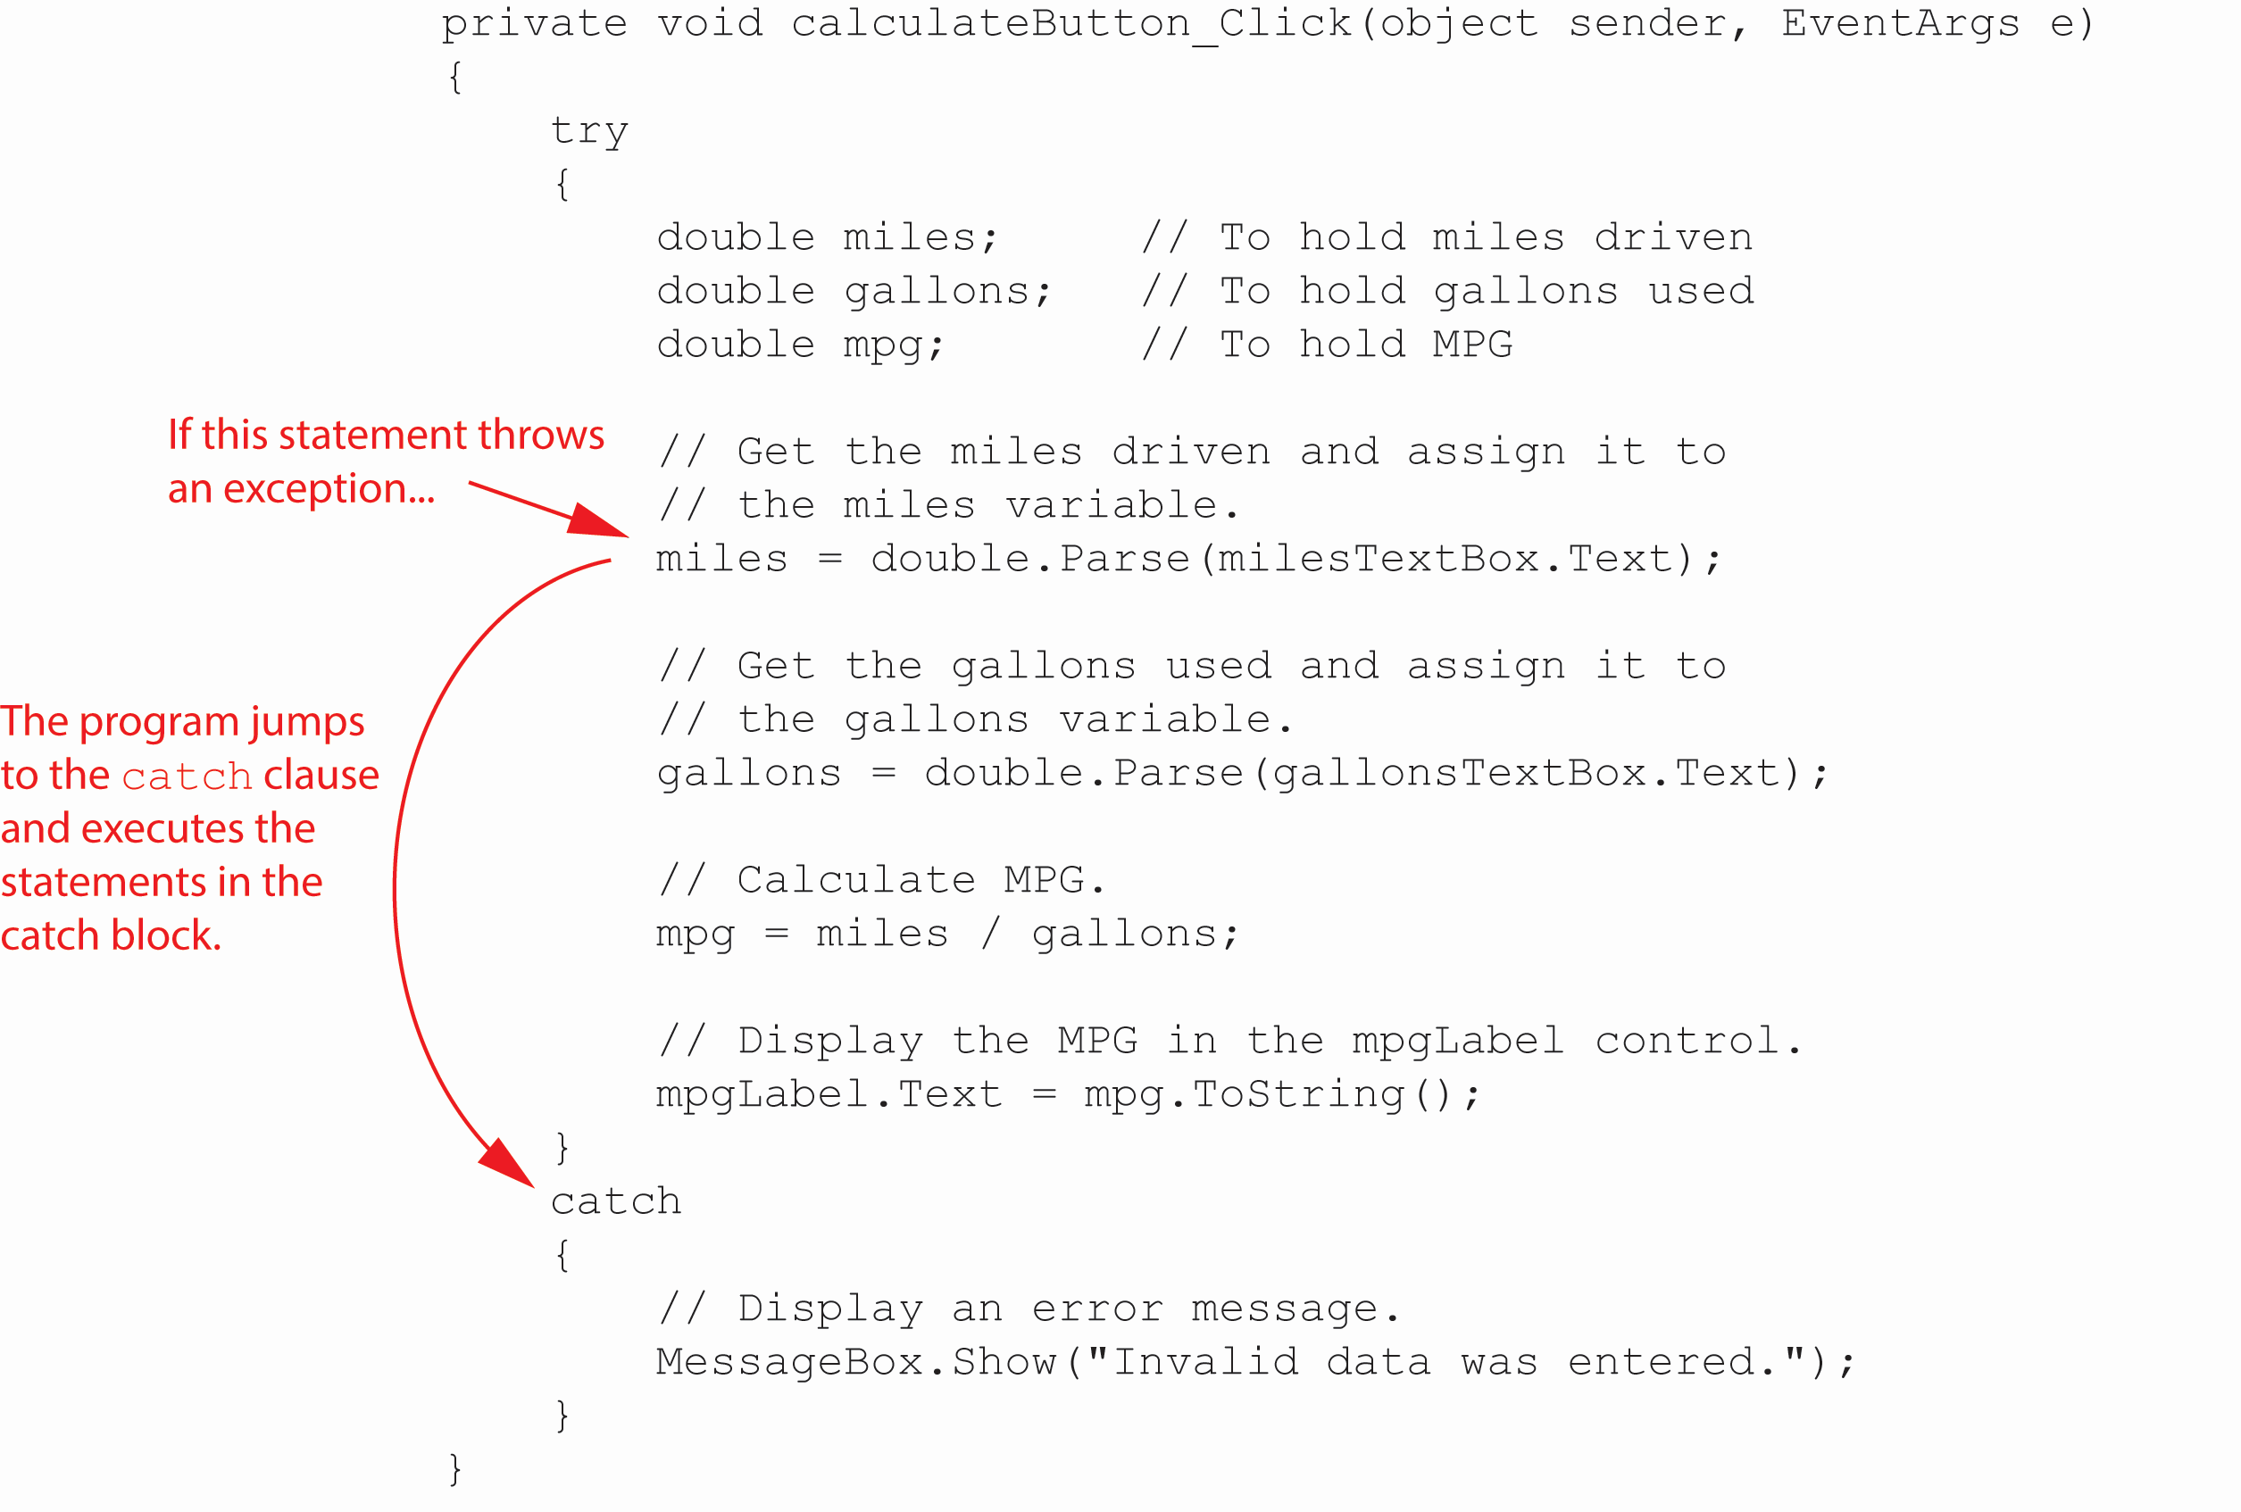
Throwing an Exception
In the following example, if the user enters nonnumeric data into the milesText control, an exception is thrown.

Slide 11
Displaying an Exception's Default Message
The Exception object's Message property holds the exception's default error message.
You can use the following format to display the exception’s error message:
try
{
statement;
statement;
etc.
}
catch (Exception ex)
{
MessageBox.Show(ex.Message);
}

Slide 12
Tab Order
When an application is running, one of the form’s controls always has the focus
Focus means a control receives the user’s keyboard input
When a button has the focus, pressing the Enter key can execute the button’s Click event handler
The order in which controls receive the focus is called the tab order
When the user presses the tab key to select controls, the program will follow the tab order
The TabIndex property contains a numeric value indicating the control’s position in the tab order
The value starts with 0. The index of first control is 0, the nth control is n-1.

Slide 13
Tab Order (1 of 2)
To set the tab order of a control, click Tab Order on the View menu. This activates the tab-order selection mode on the form.
Simply click the controls with the mouse in the order you want.
Notice that Label controls do not accept input from the keyboard. They cannot receive focus.
Their TabIndex values are irrelevant

Slide 14
Tab Order (2 of 2)
You can use the Focus method to change the focus using the following syntax:
ControlName.Focus();
The following changes the focus to nameTextBox when the user clicks the Clear button:
private void clearButton_Click(object sender, EventArgs e)
{
nameTextBox.Focus();
}

Slide 15
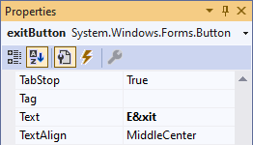
Assign Keyboard Access Key to Buttons
An access key (or mnemonic) is a key that is pressed in combination with the Alt key to quickly access a control
You can assign an access key to a button’s Text property by adding an ampersand (&) before a letter
The user can use the keystrokes Alt + X or Alt + x.
An access key does not distinguish between uppercase and lowercase

Slide 16
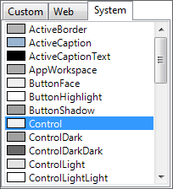
Setting Colors
Forms and most controls have a BackColor property
Controls that can display Text also have a ForeColor property
These color-related properties support a drop-down list of colors
The list has tree tabs:
Custom: display a color palette
Web: list colors displayed with consistency in Web browsers
System: list colors defined in current Windows
You can set colors in color
The .NET Framework provides numerous values that represent colors
messageLabel.BackColor = Color.Black;
messageLabel.ForeColor = Color.Yellow;

Slide 17
Background Images for Forms
A Form has a property named BackgroundImage that is similar to the Image property of a PictureBox.
Simply import an image to the Select Resource window
A Form also has a BackgroundImageLayout property that is similar to the SizeMode property of a PictureBox.
Choose from one of the following options

Slide 18
Background Images for Forms

Slide 19
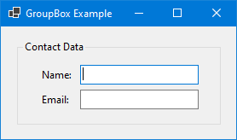
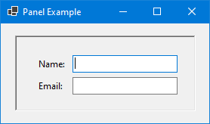
GroupBoxes versus Panels
A GroupBox control is a container with a thin border and an optional title that can hold other controls
A Panel control is also a container that can hold other controls
There are several primary differences between a Panel and GroupBox:
A panel cannot display a title and does not have a Text property, but a GroupBox supports these two properties.
A panel’s border can be specified by its BorderStyle property, while the GroupBox cannot be

Slide 20
Using the Debugger to Locate Logic Errors
A logic error is a mistake that does not prevent an application from running, but causes the application to produce incorrect results.
Mathematical errors
Assigning a value to the wrong variable
Assigning the wrong value to a variable
etc.
Finding and fixing a logic error usually requires a bit of detective work.
Visual Studio provides debugging tools that make locating logic errors easier.

Slide 21
Breakpoints (1 of 2)
A breakpoint is a line you select in your source code.
When the application is running and it reaches a breakpoint, the application pauses and enters break mode.
While the application is paused, you may examine variable contents and the values stored in certain control properties.

Slide 22
Breakpoints (2 of 2)

Slide 23
Break Mode
In Break mode, to examine the contents of a variable or control property, hover the cursor over the variable or the property's name in the Code editor.

Slide 24
The Locals and Watch Windows
The Locals window displays a list of all the variables in the current procedure. The current value and the data type of each variable are also displayed.
The Watch window allows you to add the names of variables you want to watch. This window displays only the variables you have added. Visual Studio lets you open multiple Watch windows.
You can open any of these windows by clicking Debug on the menu bar, then selecting Windows, and then selecting the window that you want to open.

Slide 25
The Locals Window
Local variables
Current values

Slide 26
Single-Stepping (1 of 2)
Visual Studio allows you to single-step through an application’s code once its execution has been paused by a breakpoint.
This means that the application's statements execute one at a time, under your control.
After each statement executes, you can examine variable and property values.
This process allows you to identify the line or lines of code causing the error.

Slide 27
Single-Stepping (2 of 2)
To single-step, do any of the following:
Press F11 on the keyboard, or
Click the Step Into command on the toolbar, or
Click Debug on the menu bar, and then select Step Into from the Debug menu

Slide 28
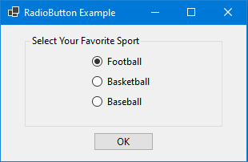
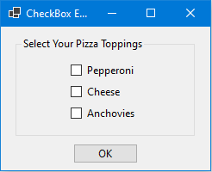
Radio Buttons and Check Boxes
Radio buttons allow users to select one choice from several possible choices
Clicking on a radio button, the program automatically deselects any others. This is known as mutually exclusive selection
Check boxes allows users to select multiple options

Slide 29
RadioButton Control
.N E T provides the RadioButton Control for you to create a group of radio buttons
Common properties are:
Text: holds the text that is displayed next to the radio button
Checked: a Boolean property that determines whether the control is selected or deselected

Slide 30
Working with Radio Buttons in Code
In code, use a decision structure to determine whether a RadioButton is selected. For example,
if (choiceRadioButton.Checked) { } else { }
You do not need to use the == operator, although the following is equivalent to the above
if (choiceRadioButton.Checked == true) { } else { }

Slide 31
Checkbox Control
The .NET Framework provide the CheckBox Control for you to give the user an option, such as true/false or yes/no
Common properties are:
Text: holds the text that is displayed next to the radio button
Checked: a Boolean property that determines whether the control is selected or deselected
In code, use a decision structure to determine whether a CheckBox is selected. For example,
if (option1CheckBox.Checked) { } else { }

Slide 32
The CheckedChanged Event
Anything a radio button or a check box control's Checked property changes, a CheckedChanged event is raised
You can create a CheckedChanged event handler and write code to respond to the event
Double click the control in the Designer to create an empty CheckedChanged event handler similar to:
private void yellowRadioButton_CheckedChanged(object sender, EventArgs e)
{
}

Slide 33
4.9 Radio Buttons and Check Boxes
Radio buttons allow users to select one choice from several possible choices
Clicking on a radio button, the program automatically deselects any others. This is known as mutually exclusive selection
Check boxes allows users to select multiple options

Slide 34
RadioButton Control
.N E T provides the RadioButton Control for you to create a group of radio buttons
Common properties are:
Text: holds the text that is displayed next to the radio button
Checked: a Boolean property that determines whether the control is selected or deselected

Slide 35
Working with Radio Buttons in Code
In code, use a decision structure to determine whether a RadioButton is selected. For example,
if (choiceRadioButton.Checked) { } else { }
You do not need to use the == operator, although the following is equivalent to the above
if (choiceRadioButton.Checked == true) { } else { }

Slide 36
Checkbox Control
The .NET Framework provide the CheckBox Control for you to give the user an option, such as true/false or yes/no
Common properties are:
Text: holds the text that is displayed next to the radio button
Checked: a Boolean property that determines whether the control is selected or deselected
In code, use a decision structure to determine whether a CheckBox is selected. For example,
if (option1CheckBox.Checked) { } else { }

Slide 37
The CheckedChanged Event
Anything a radio button or a check box control's Checked property changes, a CheckedChanged event is raised
You can create a CheckedChanged event handler and write code to respond to the event
Double click the control in the Designer to create an empty CheckedChanged event handler similar to:
private void yellowRadioButton_CheckedChanged(object sender, EventArgs e)
{
}

Slide 38
4.10 The switch Statement
The switch statement lets the value of a variable or an expression determine which path of execution the program will take
It is a multiple-alternative decision structure
It can be used as an alternative to an if-else-if statement that tests the same variable or expression for several different values

Slide 39
List Boxes
A ListBox controldisplays a list of items and allows the user to select an item from the list
Commonly used properties are:
Text: Contains the text of the currently selected item in the ListBox
Items: Contains the items of the ListBox
Items.Count: Contains the number of items in the ListBox
SelectedItem: Gets or sets the currently selected item in the ListBox. When the user selects an item, the item is stored in this property. You can use the following to get the selected item from a list box:
selectedFruit = fruitListBox.SelectedItem.ToString();
SelectedIndex: Gets or sets the zero-based index of the currently selected item in a ListBox

Slide 40
SelectedItem
An exception will occur if you try to get the value of a ListBox’s SelectedItem property when no item is selected
Items in a list box have an index starting with 0
The first item has index 0, the nth item has index n-1
The SelectedIndex property keeps the index. If no item is selected the, value of SelectedIndex is -1
The following is an example using the SelectedIndex property to make sure that an item is selected before the value is gotten from SelectedItem.
if (fruitListBox.SelectedIndex != -1 )

Slide 41
Adding Items to a ListBox
The Items.Add method allows you to add an item to the ListBox
ListBox.Items.Add(NewItem);
where ListBox is the name of the ListBox control; NewItem is the value to be added to the ListBox
Example:
daysListBox.Items.Add("Monday");
daysListBox.Items.Add("Tuesday");
daysListBox.Items.Add("Wednesday");

Slide 42
Removing Items From a ListBox
The Items.Remove method removes a specific item from a ListBox
ListBox.Items.Remove(Item);
where ListBox is the name of the ListBox control; Item is the item to be removed from the ListBox
Example:
daysListBox.Items.Remove("Tuesday");

Slide 43
Removing Items From a ListBox
The Items.RemoveAt method removes an item at a specific index from a ListBox
ListBox.Items.RemoveAt(Index);
where ListBox is the name of the ListBox control; Index is the index of the item to be removed from the ListBox
Example:
Note: the specified index must be a valid index. It cannot be less than 0, or greater than or equal to the number of items in the ListBox. If the index is invalid, the RemoveAt method will throw an exception.
daysListBox.Items.RemoveAt(2);

Slide 44
Clearing a ListBox
The Items.Clear method erases all the items in the ListBox
Example:
daysListBox.Items.Clear();

Slide 45
Using Files for Data Storage
When a program needs to save data for later use, it writes the data in a file
There are always three steps:
Open the file: create a connection between the file and the program
Process the file: either write to or read from the file
Close the file: disconnect the file and the program
In general, there are two types of files:
Text file: contains data that has been encoded as test using a scheme such as Unicode
Binary file: contains data that has not been converted to text. You cannot view the contents of binary files with a text editor.
This chapter only works with text files

Slide 46
File Accessing
A file object is an object that is associated with a specific file and provides a way for the program to work with that file
.N E T provides two classes to work with file objects:
StreamWriter: for writing data to a text file
StreamReader: for reading data from a text file

Slide 47
Writing Data to a File
Start with creating a StreamWriter object
StreamWriter outputFile;
Use one of the File methods to open the file to which you will be writing data. Sample File methods are:
File.CreateText
File.AppendText
Use the Write or WriteLine method to write items of data to the file
Close the connection.

Slide 48
Sample Code (4 of 4)
StreamWriter outputFile;
outputFile = File.CreateText("courses.txt");
outputFile.WriteLine("Introduction to Computer Science");
outputFile.WriteLine("English Composition");
outputFile.WriteLine("Calculus I");
outputFile.Close();
The WriteLine method writes an item of data to a file and then writes a newline characters which specifies the end of a line
The Write method writes an item to a file without a newline character

Slide 49
CreateText versus AppendText
The previous code uses the File.CreateText method for the following reasons:
It creates a text file with the name specified by the argument. If the file already exists, its contents are erased
It creates a StreamWriter object in memory, associated with the file
It returns a reference to the StreamWriter object
When there is a need not to erase the contents of an existing file, use the AppendText method
StreamWriter outputFile;
outputFile = File.AppendText("Names.txt");
outputFile.WriteLine("Lynn");
outputFile.WriteLine("Jamal");
outputFile.WriteLine("Alex");
outputFile.Close();

Slide 50
Specifying the Location of an Output File
If you want to open a file in a different location, you can specify a path as well as filename in the argument
Be sure to prefix the string with the @ character
StreamWriter outputFile = File.AppendText(@"C:\Data\Names.txt");

Slide 51
Reading Data from a File
Start with creating a StreamReader object
StreamReader inputFile;
Use the File.OpenText method to open the file to which you will be writing data
inputFile = File.OpenText("students.txt");
Use the Read or ReadLine method to write items of data to the file
StreamReader.ReadLine: Reads a line of characters from the current stream and returns the data as a string.
StreamReader.Read: Reads the next character or next set of characters from the input stream.
Close the connection

Slide 52
Reading a File with a Loop
StreamReader objects have a Boolean property named EndOfStream that signals whether or not the end of file has been reached
You can write a loop to detect the end of the file.
while (inputFile.EndOfStream == false)
{
}
Or
while (!inputFile.EndOfStream)
{
}

Slide 53
The OpenFileDialog and SaveFileDialog Controls
The OpenFileDialog and SaveDialog controls allow your application to display standard Windows dialog boxes for opening and saving files
Unlike Label, Button, and TextBox, they are invisible controls
The OpenFileDialog control displays a standard Windows Open dialog box.
The SaveDialog control displays a standard Windows Save As dialog box

Slide 54
Displaying an Open Box (1 of 2)
When adding an OpenFileDialog control to the form, it does not appear on the form but in an area at the bottom of the Designer called the component tray

Slide 55
Displaying an Open Box (2 of 2)
In code, you can display an Open dialog box by calling the ShowDialog method:
private void openButton_Click(object sender, EventArgs e)
{
openFileDialog.ShowDialog();
}

Slide 56
Detecting the User’s Selection
The showDialog method returns a DialogResult value that indicates which button the user clicks to dismiss the dialog box
If the user clicked the Open button, the value DialogResult.OK is returned
If the user clicked the Cancel button, the value DialogResult.Cancel is returned
The following is an example that calls the ShowDialog method to determine the user’s choice:
DialogResult result = openFileDialog.ShowDialog();
if (result == DialogResult.OK)
{
}
else if (result == DialogResult.Cancel)
{
}

Slide 57
The Filename and InitialDirectory Property
When the user selects a file with the Open dialog box, the file’s path and filename are stored in the control’s Filename property
The following is an example of how to open the selected file:
if (openFileDialog.ShowDialog() == DialogResult.OK)
{
inputFile = File.OpenText(openFileDialog.Filename);
}
You can specify a directory to be initially displayed with the InitialDirectory property. For example,
openFileDialog.InitialDirectory = @"C:\Data";

Slide 58
Displaying a Save As Dialog Box
Use the following to call the SaveFileDialog control’s ShowDialog method
saveFileDialog.ShowDialog()
Use the following to detect the user’s choice
if (saveFileDialog.ShowDialog() == DialogResult.OK)
{
}
Use the following to open the selected file
if (saveFileDialog.ShowDialog() == DialogResult.OK)
{
outputFile = File.CreateText(openFile.Filename);
}

Slide 59
5.8 Random Numbers
.N E T provides the Random class to generate random numbers.
To create an object, use:
Random rand = new Random();
Two commonly used methods to generate random numbers are:
Next: randomly create an integer
NextDouble: randomly create a floating-point number from 0.0 to 1.0
Examples,
int number1 = rand.Next();
double number2 = rand.NextDouble();

Slide 60
Syntax of the Random.Next Method
Random.Next generates a random number whose value ranges from 0 to 2,147,483,647
It also allows you to generate a random number whose value ranges from zero to some other positive number. The syntax is:
RandomObject.Next(max + 1)
For example, to create a random number from 0 to 99, use:
int number = rand.Next(100);

Slide 61
The Load Event
When running an application, the application’s form is loaded into memory and an event known as Load takes place
To create a Load event handler, simply double click the form in the Designer
An empty Load event handler looks like:
private void Form1_Load(object sender, EventArgs e)
{
}

Slide 62
The Load Event
Any code you write inside the Load event will execute when the form is launched. For example,
private void Form1_Load(object sender, EventArgs e)
{
MessageBox.Show("Prepare to see the form!");
}

Slide 63
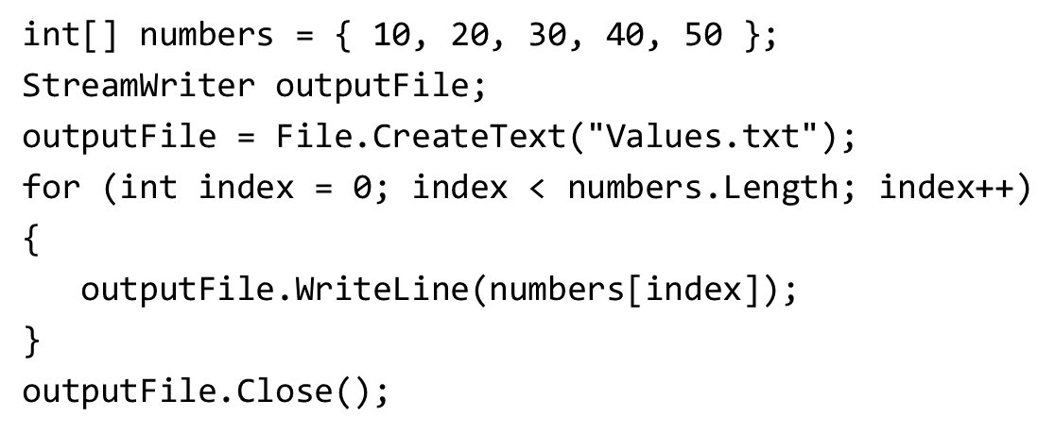
Working with Files and Array
The book demonstrates how to write an array’s contents to a file. Here is the code:

Slide 64
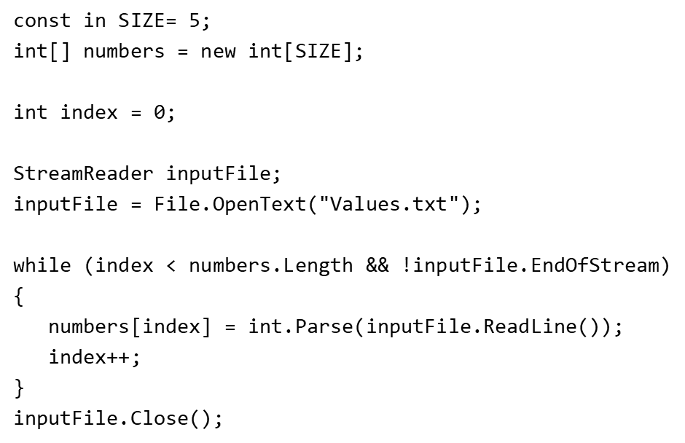
Reading Values from a File to An Array
The book demonstrates how to read values from a file and store them in an array. Here is the code:

